Slide 1
Getting started REACT24K
Info session 10.01.2024

Slide 2
Agenda for the first day
08:30 – 11:00 Meeting with the PCDP instructor, room 460
08.30 – 08.45 Agenda for the first day
08.30 – 08.45 Getting to know you, and your classmates
08:45 – 11.00 Practical information session and Tools
- Wilma
- itsLearning
- MS Teams
- Office 365
- VS Code
11.30 – 11.45 Lunch break
11:45 – Teaching begins according to the timetable, classroom 259
Note: Must login to these tools before you leave today

Slide 3
Tutor teacher (PCDP instructor)
Santosh Kalwar
Doctor of Science in Tech., LUT, 2014
Santosh.Kalwar@bc.fi
+358 447 756 412
https://www.linkedin.com/in/santoshkalwar
https://github.com/kalwar
Preferred name: Santosh
Preferred communication channel: MS Teams Chat

Slide 4
PCDP mandatory meeting
PCDP stands for Personal Competence Development Plan
Will be scheduled soon, 1st – 3rd week
30 minutes per student
Together we develop your study plan
I will send invitation in your official school email via MS Teams
Make sure your MS Teams is ON during study time
https://en.bc.fi/student-services/guidande-and-support/pcdp-instructor/

Slide 5
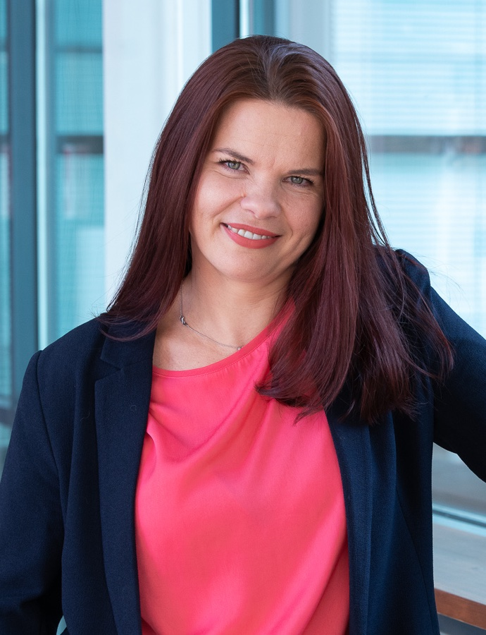
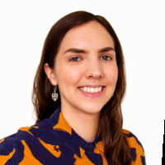
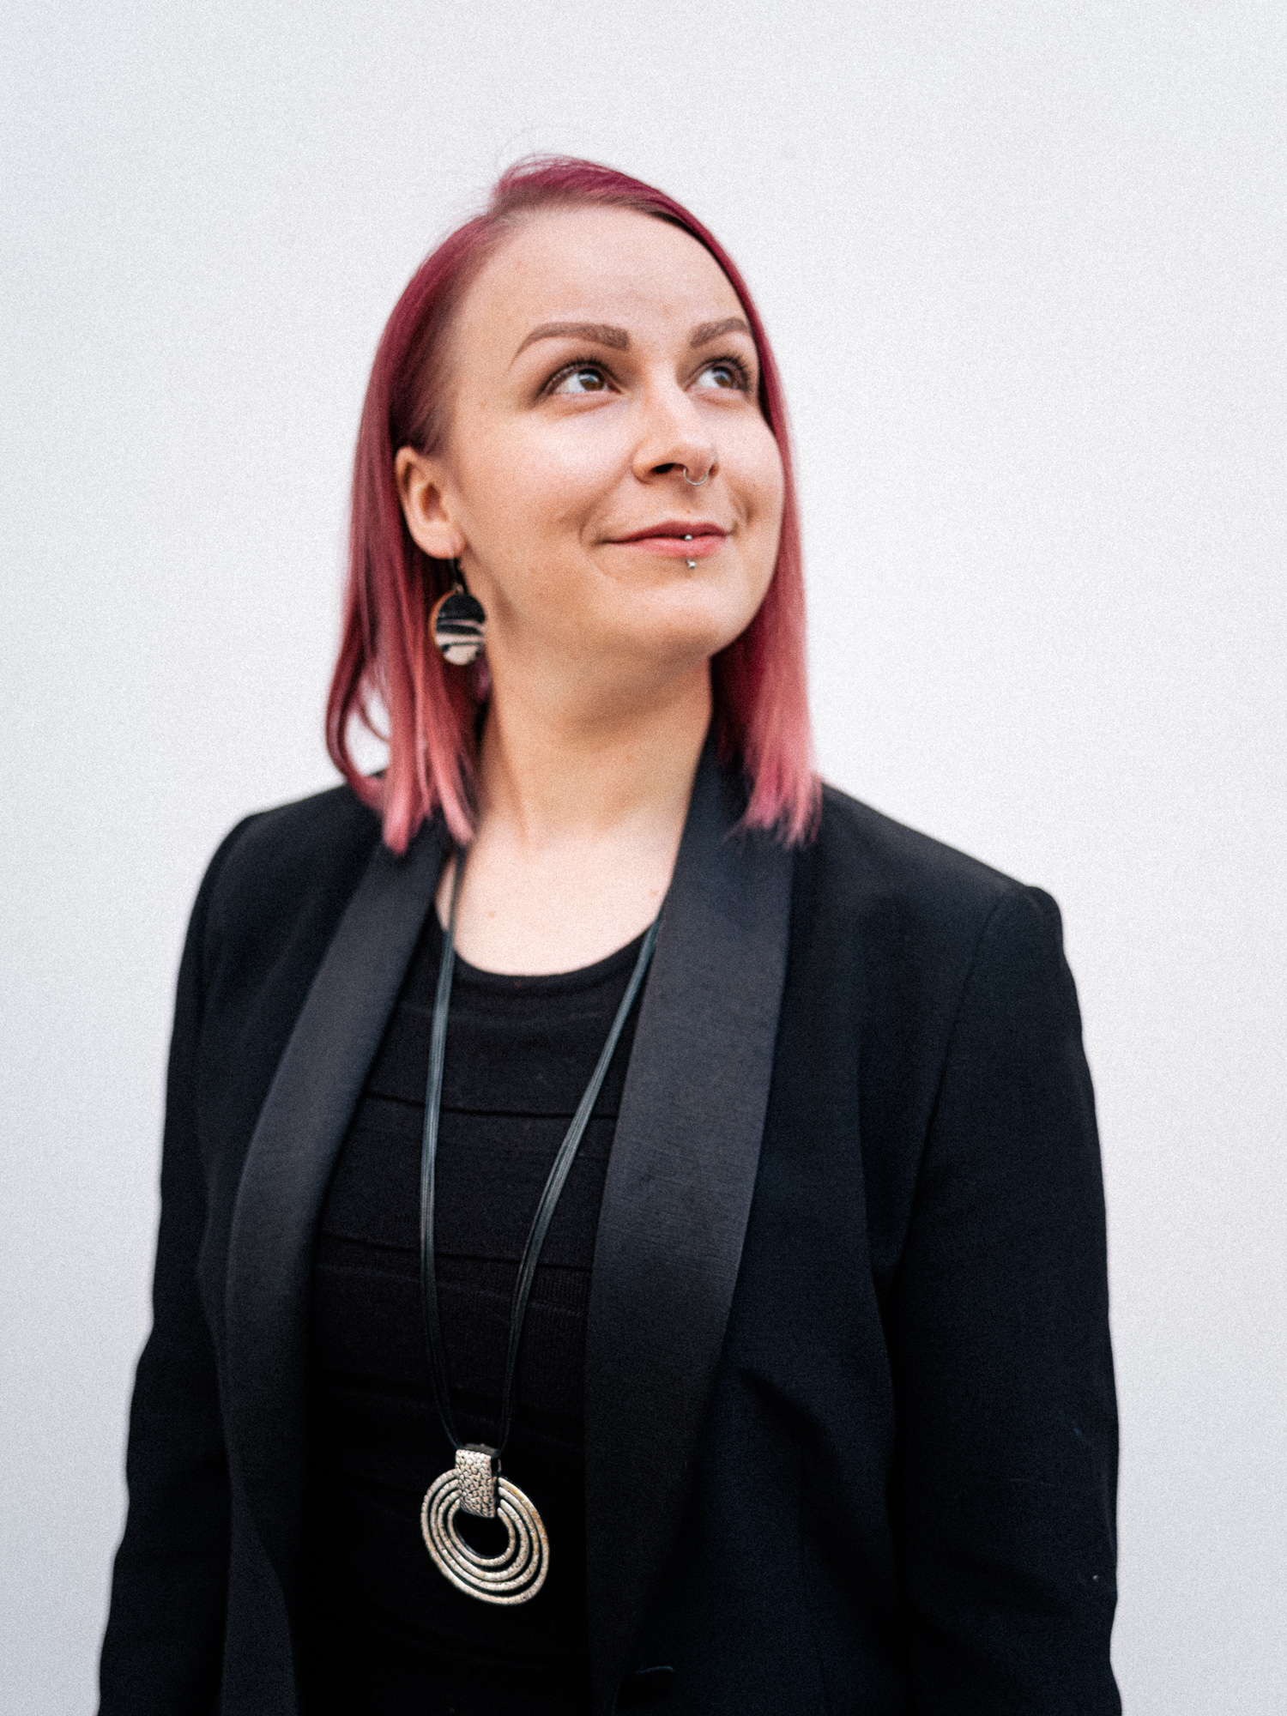
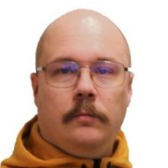

Program course teachers
Margit Tennosaar
Elina Kuutti
Vera Schneider
Joonas Iivonen
joonas.iivonen@bc.fi
Ilkka Heliö
margit.tennosaar@bc.fi
elina.kuutti@bc.fi
vera.schneider@bc.fi
ilkka.helio@bc.fi

Slide 6
First things first - WiFi
School laptop, many services works only in this network:
BC-WLAN
username: your-AD-username password: your-AD-password BC-PUBLIC
username: BC-PUBLIC
password: freenetBC

Slide 7









Average age: 32,6 years old Youngest: 20 years Oldest: 55 years
Sex
Graduation
After Graduation
graduated still learning
left program
female
male
working in SW-business Continued studies looking job
Data provided by: Margit Tennosaar

Slide 8
Full Stack Web Developer program React & Drupal (17 months)
Programming, 45 cr
Working as a software developer, 45 cr
Software implementation using a software component library, 30 cr
https://eperusteet.opintopolku.fi/#/en/esitys/6779583/reformi/tutkinnonosat

Slide 9

1st period – 9 weeks
2nd period – 9 weeks
Software Development Teamwork 1 – 3 weeks
3rd period – 9 weeks
4th period – 9 weeks
Software Development Teamwork 2
Internship – 9-18 weeks

Slide 10
Courses
First period 2023 (10.1-20.03.2024)
Second period 2023 (21.03-22.05.2024)
Working in a Software Development Team
HTML5 and CSS3
UI Design and Prototyping
Programming JavaScript
Programming PHP
Programming PHP
Symfony Framework
Databases and Data structures
React Basics

Slide 11
Courses
Summer 2023 (23.05-10.06.2024)
First period of fall 2023 (08.08-09.10.2024)
Software development team project 1
Drupal module development
Continuous Integration and AWS
React Advanced
Unit testing and Quality Assurance
Internship period (09.01-05.05.2025)
On-the-job learning period as an unpaid internship (training agreement contract) or as a paid internship (apprenticeship + employment contract).

Slide 12
Semesters and timetables
1. period, 10.01. - 20.03.2024
2. period, 21.03. - 22.05.2024
3. period, 23.05. - 12.06.2024
4. period, 12.08. - 09.10.2024
Internship (09.01. - 05.05.2025)

Slide 13
Holidays
Autumn break: 14.10.2024 – 18.10.2024
Christmas break: 21.12.2024- 06.01.2025
Winter break: 19.2.2024- 25.2.2024
Easter break: 29.3.2024- 1.4.2024
https://en.bc.fi/student-services/schedules-and-holidays/

Slide 14
Study is full time
Monday to Friday
- 9:30-15:00
School premises only
Check Wilma for classroom allocation
Presence is checked
Leaves must be marked to Wilma in advance
(Note: Alway inform in advance about anything to your PCDP instructor and/or to your class teacher)

Slide 15
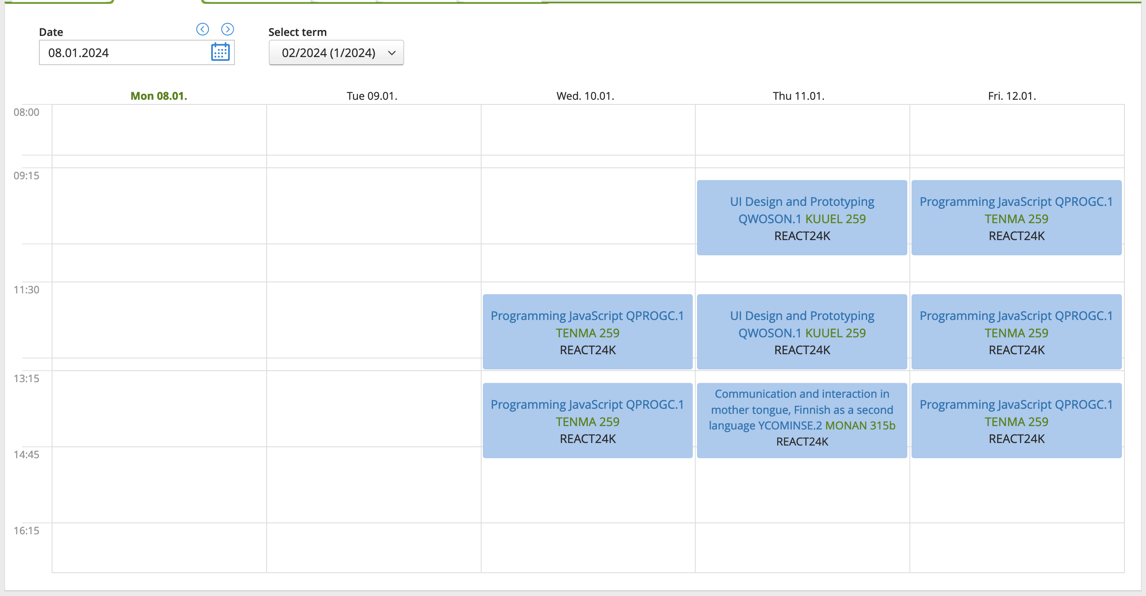
First week timetable
https://bc.inschool.fi/profiles/classes/1488/schedule

Slide 16
Essential information 1/2
Students intra
https://opiskelija.bc.fi/en/
Psychologist Eija Kallunki
room 217, phone 050 401 3277, eija.kallunki@edu.hel.fi
Study counsellor Maija Vuorjoki
room 218a, phone: 044 775 6419 (call/text- and WA-message), maija.vuorjoki@bc.fi Appointment booking with Maija https://outlook.office365.com/owa/calendar/Guidancecouncelling@businesscollege.onmicrosoft.com/bookings/

Slide 17

Essential information 2/2
https://www.youtube.com/watch?v=Q_SNIAtXEyo

Slide 18
Mandatory tools
MS Teams – main tool for instant messages
Wilma – official communication between student and teachers
Itslearning – course materials
Email – communication between teacher and internship place
Github – version control and source code repository
Visual Studio Code

Slide 20
Login
You can login to virtual learning environments (Wilma, ItsLearnging, MS Office365…) using same credentials what was given to you.
Username: studentID@edu.bc.fi or studentID
studentID is in the form s + student number (e.g. s1234567)

Slide 21
Welcome!
Let’s work together and make IT!

